Slide 1


How do human beings process degraded speech?
Toronto, 22 Nov. 2022
Ya-Ping Chen
Centre for Cognitive Neuroscience,
University of Salzburg,
Salzburg, Austria

Slide 2
How human beings process degraded speech?
Two studies
Study 1: on a short-time level (under review at NeuroImage)
How speech intelligibility modulates neural speech tracking within 400 ms?
Study 2: on a long-time level (in preparation)
How speech intelligibility representations of non-CI ear change over a year?

Slide 3
Study 1
How does speech intelligibility modulate neural speech tracking within 400 ms?
Ya-Ping Chen, Fabian Schmidt, Anne Keitel, Sebastian Rösch, Anne Hauswald, & Nathan Weisz

Slide 4
Background
Higher neural speech tracking on attended speech (Ding & Simon, 2012; Fiedler et al., 2019; Hausfeld et al., 2018).
Study 1

Slide 5
Background
Few studies focused on how speech intelligibility affects the temporal dynamics of neural speech tracking (xxx).
Research Question
How does speech intelligibility modulate neural speech tracking?

Slide 6
Study Paradigm

Slide 7
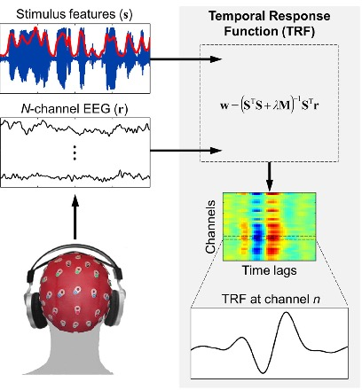
Computing TRFs to depict dynamic neural speech tracking
Crosse et al., 2016, Frontiers in Human Neuroscience
Study 1

Slide 8
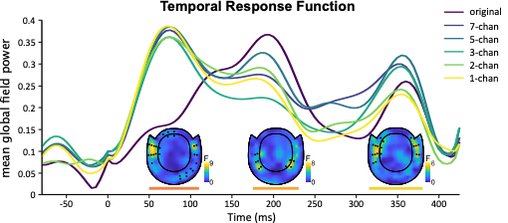
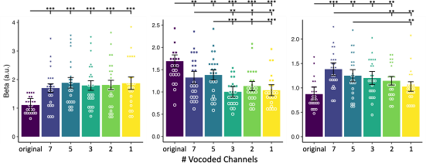
Study 1

Slide 9
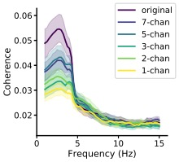
Speech-Brain Phase Coherence
Coherence Spectrum
Study 1

Slide 10
Parameterizing Power Spectrum
adapted from https://fooof-tools.github.io/fooof/
Donoghue et al. (2020) Nature Neuroscience
Study 1

Slide 11
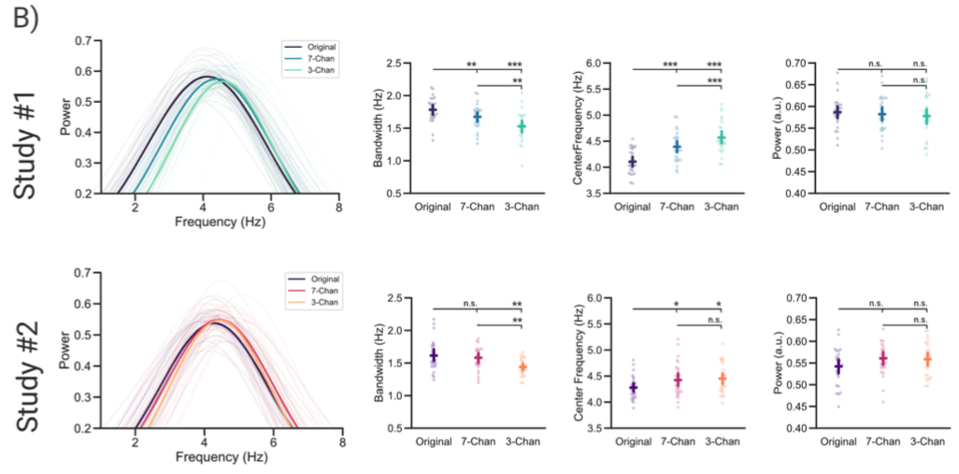
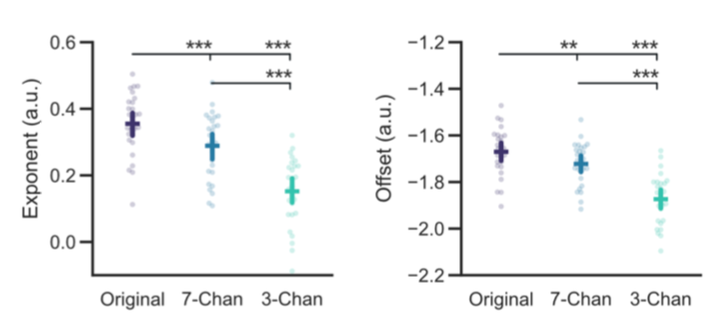
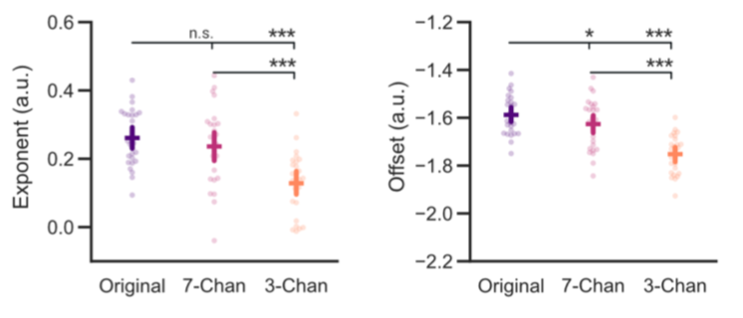
Parameterizing Phase Coherence
Bandwidth
Center Frequency
Height
Exponent
Offset
Schmidt et al. (2022) under review at Psychophysiology
Study 1

Slide 12
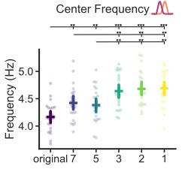
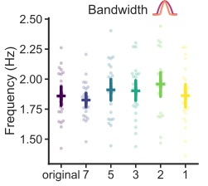
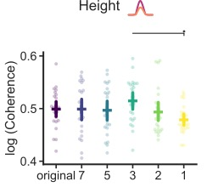
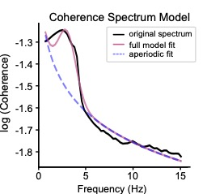
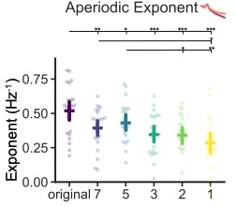
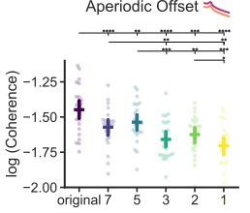
Parameterizing Phase Coherence
Study 1

Slide 13
Study 1

Slide 14
Conclusion of Study 1
We demonstrate that at least three neural processing stages (M50_{TRF}, M200_{TRF}, and M350_{TRF}) when processing continuous degraded speech.
Only M200_{TRF} highly correlates with behavior and other neural measures (i.e., speech brain coherence) of speech intelligibility.
Correlation between center frequency of coherence and M50_{TRF} as well as M200_{TRF} can reflect shifts in the neural speech tracking from more linguist level to more acoustic level as speech intelligibility declined.
Study 1

Slide 15
Study 2
Speech intelligibility representations of non-CI ear gradually normalize over a year.
Ya-Ping Chen, Patrick Neff, Sabine Leske, Daniel D.E. Wong, Nicole Peter, Jonas Obleser, Tobias Kleinjung, Andrew Dimitrijevic, Sarang Dalal, Nathan Weisz

Slide 16
Background
Individuals with a cochlear implant (CI) for treating single-sided deafness have experienced improved speech perception in noise (Peter et al., 2019).
However, it is not clear how single-sided CI users’ speech perception improves and how neural speech representation of speech intelligibility changes over a year.
Research Question
How neural speech representation of speech intelligibility changes over time in single-sided CI users (SSD-CI)?
Study 2

Slide 17

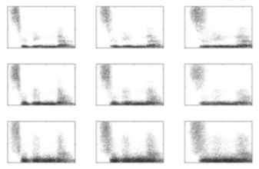

+
3 x 3 Stimulus Manipulation
0.5-1.5 s
Temporal degradation
+
monaural presentation of degraded noun
8-Hz
4-Hz
2-Hz
intelligible
~ 0.6 s
16-band
not well 1 2 3 4
comprehension rating max. 2 s
8-band
Spectral degradation
4-band
2 s
intelligible
unintelligible
Study 2
17

Slide 18
Participant
10 single-sided cochlear implant users (SSD-CI) (5 right-sided + 5 left-sided)
4 female, mean age 46.9 (27-63)
10 age-and-sex matched controls
4 female, mean age 48.2 (29-61)
Stimuli
216 standard German nouns presented monaurally to each ear
3 levels of temporal smoothing x 3 levels of spectral degradation
EEG measurement
128 channel EEG (ANT-Neuro system)
1 session for healthy controls
4 sessions for CI users
Pre-op (only healthy ear) & 3 Post-op (3, 6 & 12 months)
CI Sub ID | Age at CI Activation (yrs) | Duration of Deafness (yrs)
CI1 | 27 | 1.0
CI2 | 36 | 1.7
CI3 | 42 | 1.6
CI4 | 45 | 4.6
CI5 | 48 | 0.8
CI6 | 48 | 1.5
CI7 | 50 | 1.5
CI8 | 54 | 1.2
CI9 | 56 | 1.3
CI10 | 63 | 1.4
Study 2

Slide 19
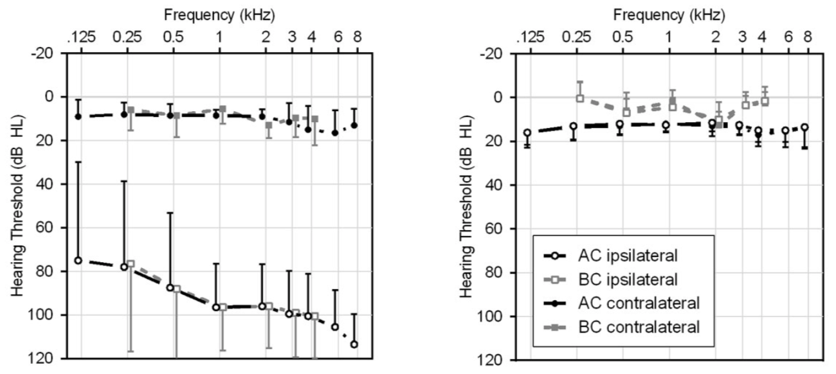
Preoperative Pure Tone Audiograms
SSD-CI
Healthy Control
Peter et al. (2019) Swiss Med Wkly
Study 2

Slide 20
Behavioral Results
Study 2

Slide 21
Representational Similarity Analysis (RSA)
Study 2

Slide 22
Non-CI Ear
CI Ear
Study 2

Slide 23
Shared Representations between SSD-CI users and healthy controls
Study 2

Slide 24
Study 2

Slide 25
Conclusion of Study 2
The CI benefits not only the CI ear but also the non-CI ear.
We show that auditory cortical speech processing after CI implantation gradually normalizes towards generally normal functioning within months.
Study 2

Slide 26


Andrew Dimitrijevic
University of Toronto
Anne Keitel
University of Dundee, UK
Daniel D.E. Wong
Universität Konstanz, Germany
Jonas Obleser
University of Lübeck, Germany
Nicole Peter
Tobias Kleinjung
University of Zurich, Switzerland
Sabine Leske
University of Oslo, Norway
Sarang Dalal
Aarhus University, Denmark
Sebastian Rösch
Paracelsus Medical University, Austria

Slide 27
Thank you for your time!

